Slide 1




Retail Life – Print Policy Automation Summary
Presented To: NYL Team
Presented By: Trianz Team
Date: 02/18/2025

Slide 2







Key Topics
Overview - Process Flow
1
Benefits and Efficiency
2
Challenges -> Solution and Key take aways
3
Appendix
4
Print Policy Automation

Slide 3

Overview of FAST System - Print Policy Correspondence Event and Automation
When a New Business Case is issued or Re-Issued through the FAST system, a critical event known as the Print Policy Correspondence Event is automatically generated. This event serves as a key step in the process of communicating important details of the policy to both the policyholder and internal stakeholders. The event ensures that all essential information about the policy is documented, printed, and communicated in a timely and accurate manner.
In order to maintain the consistency and accuracy the automation ensure that the Print Policy generated from the JSON file always contains accurate and consistent policy information.
We are automating the validation process by using scripts to verify the accuracy, formatting, and consistency of JSON data in Print Policy documents.
Overview
What Automation doing is ..
Reference
Input
Mapping
Trigger execution
Output
Print Policy Extract and TRAD
Automation Mapping document
It acts as bridge between Print Policy Extract and TRAD to link the fields between two files
Automation QA team will Initiating the Automation Test Run refers to the process of starting an automated sequence of tests
HTML – Report – Where we need valuable input from our service team

Slide 4
Benefits
Consistency and Accuracy
Automation Testing can quickly verify that the JSON file has the right data and correct format without discrepancies.
E.g. Automated tests will validate the consistency between the JSON data and the admin system . In case of any issues ,the next action can be taken and avoid the remediations
Regression Testing
Automation Testing allows quick re-testing of all previously verified conditions.
E.g. If the structure of the policy document changes due to a system update, automated testing can quickly ensure that the policy details in the generated Print Policy still align with the updated JSON data
Reduction of Human error
Automated tests can be run repeatedly, ensuring that the same checks are performed accurately and consistently
E.g. A tester might accidentally overlook a special condition or a conditional rule in a policy term during manual testing, but an automated test will consistently check all aspects of the policy without skipping anything.
Continuous Integration
Automated tests can be integrated into Continuous Integration (CI) pipelines. As soon as developers make changes to the system
E.g. Every time a developer commits code to a repository, automated tests can run to check if the Print Policy document still correctly reflects the data in the JSON file
Efficiency- The below data is based on latest run
# JSON Files | ~Fields / file | Duration | Expected Manual Effort | Savings | Efficiency
15 | 85 | 32 (.53 min) | 30min * 15 Files = 450 min | 449.47 | 99.88

Slide 5
Challenges Solution Key take aways
Data Extraction & Formatting Issues
Excel and JSON data may have different formats(e.g, date , currency, percentage)
Leading zeros in policy numbers may get removed
Decimal precision mismatches(e.g, 100.0 vs 100.00).
Test Reporting & Logging
Capturing meaningful logs for debugging .
Maintaining structured test reports for analysis.
Data Extraction & Formatting Issues
Use Apache POI to read Excel with proper data type handling.
Format policy numbers as strings to preserve leading zeros.
Standardize decimal places and date formats before comparison
Test Reporting & Logging
Integrate Extent Reports for detailed reporting.
Implement structured logging for failed comparisons.
Data Extraction & Formatting Issues
Consistency in data formatting is crucial for accurate validation.
Test Reporting & Logging
Clear reporting and logging improve debugging and stakeholder communication.

Slide 6


Thank you
In case of any question/concerns
Reach out @ DL- RetailLife_QA
The content in this document is copyrighted; any unauthorized use – in part or full – may violate the copyright, trademark, and other laws. This document may not be modified, reproduced or publicly displayed, performed or distributed, or used for any public or commercial purposes. The Trianz name and its products are subject to trademark and copyright protections, regardless of how and where referenced.

Slide 7
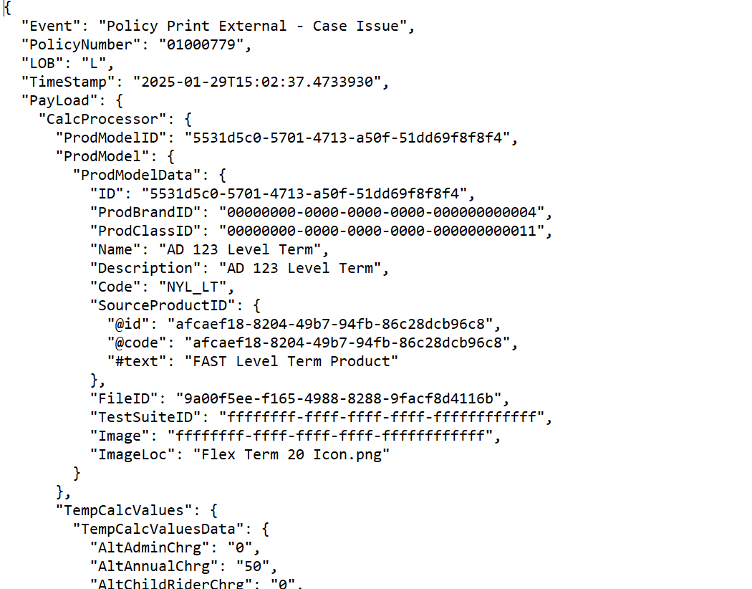
Appendix Print Policy Extract format : Retrieve JSON response of “Print Policy” when we Issue the Policy. It includes all the Policy Details, Coverage Information and Riders Information

Slide 8
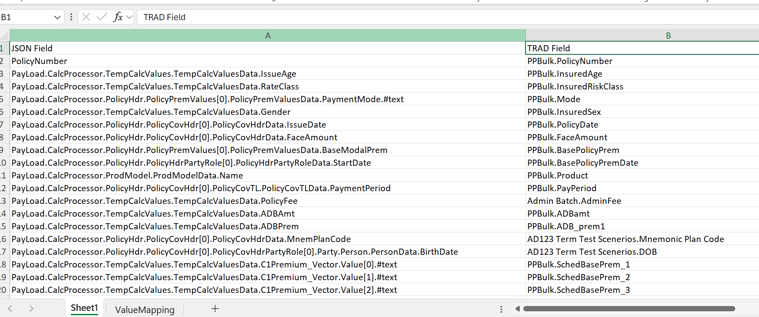
Appendix Mapping Document : The mapping document acts as a bridge between JSON and TRAD extracts to link the fields between two files.

Slide 9
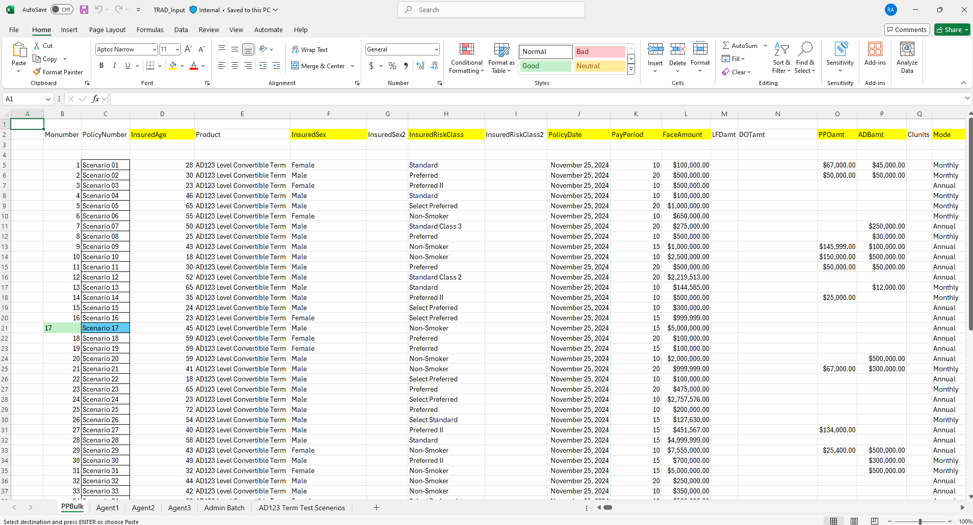
Appendix TRAD Extract file : TRAD Input sheet consists of the expected data with the fields and values calculated for the policies/scenarios in the sheets ‘PPBulk’, ‘Agent1’, ‘Agent2’, ‘Agent3’, Admin Batch’ & ‘AD123 Term Test Scenarios’(Captured from Modal Office).

